Slide 1
Google Ads
Sahar andaleeb
Week # 14-15
GOOGLE ADS
By: Sahar Andaleeb

Slide 2
Google ads
Google Ads was formerly known as Google AdWords.
Google Ads includes various types of online advertising such as search advertising, display advertising, video advertising (YouTube ads), shopping ads, app promotion, and more.
Google Ads offers a wide range of targeting options to help advertisers reach their desired audience. These options include demographics, interests, behavior, location, and more.
With Google Ads, advertisers can choose from various campaign objectives depending on their advertising goals. Such as: increasing website traffic, generating leads, driving sales, promoting brand awareness, and more.
Week # 14-15
GOOGLE ADS
By: Sahar Andaleeb

Slide 3
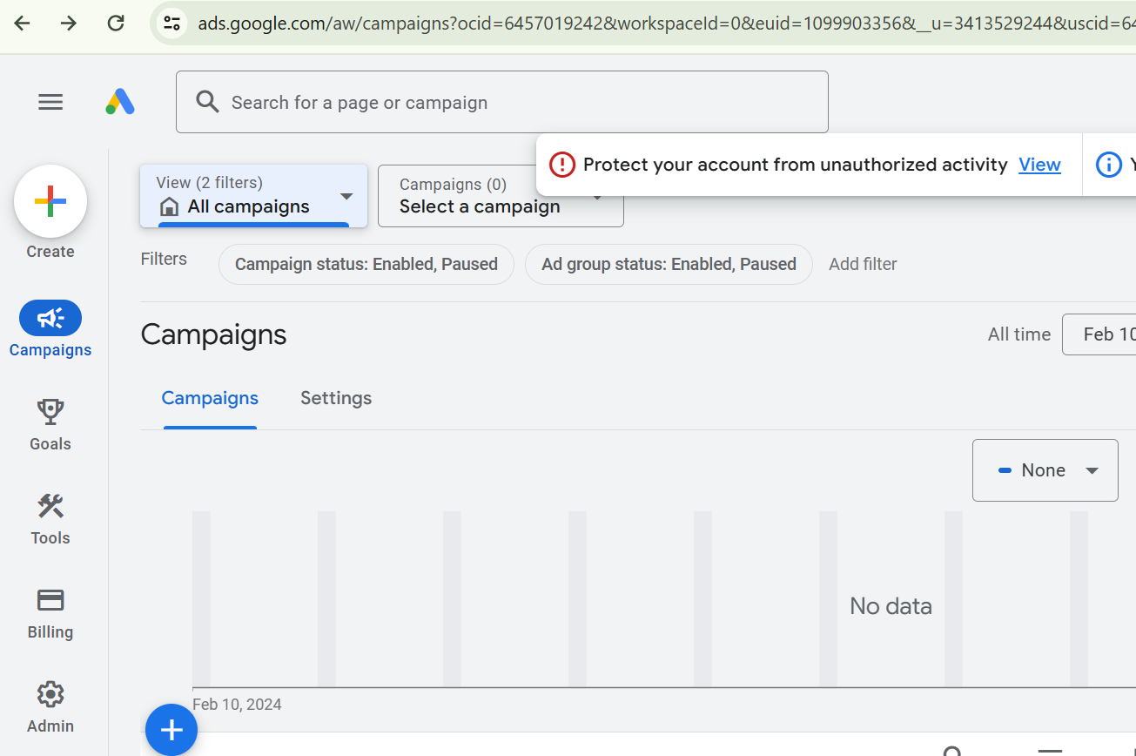
Google ads interface
ads.google.com
SignIn → Requires gmail account
Campaign Tab → New Campaing
GoogleAds Interface
Week # 14-15
GOOGLE ADS
By: Sahar Andaleeb

Slide 4
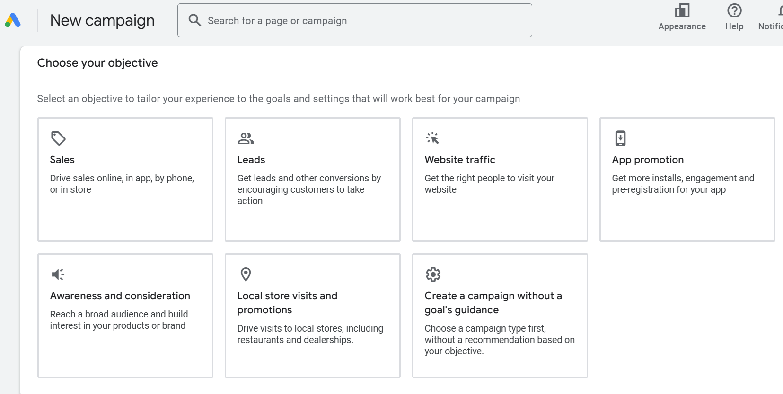
Google ads… cont.
Choosing Google Ads objective
Week # 14-15
GOOGLE ADS
By: Sahar Andaleeb

Slide 5
Google ads – objective types
Sales:
Objective: Drive direct sales of your products or services.
Purpose: Maximize revenue by encouraging users to make purchases.
When to Use: Ideal when your primary goal is to increase sales through your website or app.
Leads:
Objective: Generate potential leads or inquiries from interested customers.
Purpose: Collect valuable contact information for follow-up marketing efforts.
When to Use: Suitable when you want to build a database of potential customers or capture interest before making a sale.

Slide 6
Google ads – objective types..cont.
Website Traffic:
Objective: Increase visits to your website.
Purpose: Drive more traffic to your website to increase visibility and engagement.
When to Use: Useful for promoting content, attracting new visitors, or boosting overall website activity.
Awareness and Consideration:
Objective: Build brand awareness and encourage consideration of your products or services.
Purpose: Introduce your brand to a broader audience and engage potential customers.
When to Use: Beneficial when launching a new product, entering a new market, or increasing overall brand recognition.
Week # 14-15
GOOGLE ADS
By: Sahar Andaleeb

Slide 7
Google ads – objective types..cont.
Local Store Visits and Promotion:
Objective: Drive foot traffic to your physical store locations.
Purpose: Increase local visibility and encourage nearby customers to visit your stores.
When to Use: Perfect for businesses with brick-and-mortar locations looking to attract customers in their vicinity.
App Promotion:
Objective: Increase installations and engagement with your mobile app.
Purpose: Boost visibility and usage of your mobile application.
When to Use: Appropriate for promoting a new app or encouraging existing users to engage more with it.
Week # 14-15
GOOGLE ADS
By: Sahar Andaleeb

Slide 8
Google ads – objective types..cont.
Campaign with a Goal Guidance:
Objective: Optimize your campaign towards a specific goal, such as sales, leads, or website traffic.
Purpose: Provide guidance and optimization recommendations based on your selected goal.
When to Use: Helpful when you have a clear objective in mind.
Week # 14-15
GOOGLE ADS
By: Sahar Andaleeb

Slide 9
Google ads – campaign types
Search:
Search ads are text-based ads that appear at the top or bottom of a SERP when individuals search a keyword.
→ target users who are searching for specific keywords on search engines (Google, Bing, or Yahoo).
Display:
Display ads are image-based ads that appear on websites and applications. These ads allow you to stay top of mind by reaching your audience while they browse their favorite sites and apps. These sites and apps pull from the Google Display Network (GDN)
Video:
Video ads are advertisements that appear before, during, or at the end of videos on YouTube, Facebook, Instagram, or TikTok.
Week # 14-15
GOOGLE ADS
By: Sahar Andaleeb

Slide 10
Google ads – campaign types ..cont
Shopping:
Shopping ads are product listings that appear at the top of SERPs for product-related searches.
Shopping campaigns are specific to e-commerce businesses and allow retailers to promote their products directly within Google's search results.
App:
App campaigns are designed to promote mobile apps across various channels, including search, display, video, and app stores.
These campaigns aim to increase app installs, engagement, or in-app actions.
Smart:
Smart campaigns leverage machine learning and automation to optimize ad performance across different channels, targeting, and ad formats.
Week # 14-15
GOOGLE ADS
By: Sahar Andaleeb

Slide 11
Google ads – campaign types ..cont
Performance Max:
This is a campaign type offered by Google Ads that utilizes machine learning to automatically optimize towards various performance goals, such as conversions, clicks, or impressions..
Demand Gen (Generation):
Demand generation campaigns focus on creating awareness and interest in a product or service to drive demand and ultimately lead to conversions.
These campaigns often involve content marketing, email marketing, social media advertising, and other tactics to attract and engage potential customers.
Week # 14-15
GOOGLE ADS
By: Sahar Andaleeb

Slide 12
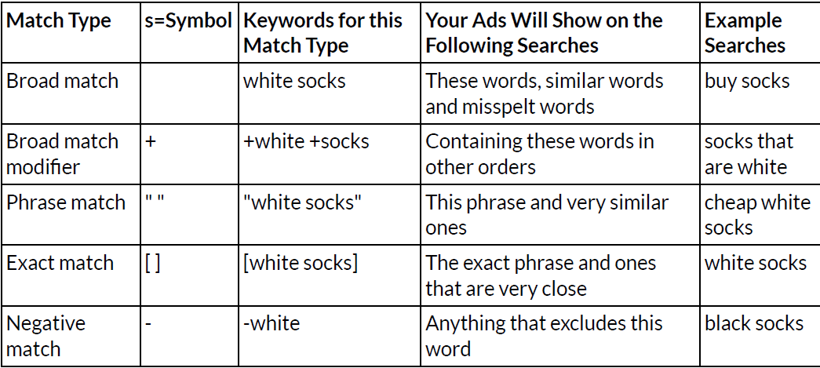
Keyword match types
Week # 14-15
GOOGLE ADS
By: Sahar Andaleeb

Slide 13
Keyword match types…broad Match
Broad Match: This is the default match type. It allows your ad to show when someone searches for any variation of your keyword, including synonyms, related searches, and other variations.
It reaches the largest audience but may be less targeted.
Example: If you bid on the keyword "women's shoes", your ad might show for searches like:
"shoes for women"
"buy shoes for women"
"ladies footwear"
"footwear for women"
Pros: Broad reach, capturing a wide audience.
Cons: May lead to irrelevant traffic and lower quality leads.
Week # 14-15
GOOGLE ADS
By: Sahar Andaleeb

Slide 14
Keyword match types… modified broad match
Modified Broad Match: This is a variation of broad match, where you can include specific words in the query. You add a "+" symbol in front of keywords to make them mandatory in the search query.
Example: If you bid on "+women's +shoes", your ad will show when someone searches for:
"buy women's shoes"
"women's shoes on sale"
"cheap shoes for women"
But not for “women sandals" (since "shoes" is required in the search).
Pros: More control than broad match, but still offers a wider reach than phrase or exact match.
Cons: Still may allow some irrelevant searches if not carefully optimized.
Week # 14-15
GOOGLE ADS
By: Sahar Andaleeb

Slide 15
Keyword match types… phrase match
Phrase Match: Ads will appear for searches that include your exact target phrase, with additional words before or after it, as long as the phrase itself remains intact.
Example: If you bid on "women's shoes" (phrase match), your ad could show for:
"buy women's shoes"
"best women's shoes for running"
"women's shoes sale"
But not for "shoes for women" (because the word order is different).
Pros: More control than broad or modified broad match, less irrelevant traffic.
Cons: Limited reach compared to broad match.
Week # 14-15
GOOGLE ADS
By: Sahar Andaleeb

Slide 16
Keyword match types… Exact match
Exact Match: Ads only show when the search query exactly matches the keyword or is a close variant (e.g., plurals, misspellings).
This is the most restrictive match type but offers the most control and precision.
Example: If you bid on [women's shoes] (exact match), your ad will show only for:
"women's shoes"
"women shoe" (close variation)
Pros: Very targeted, with highly relevant traffic.
Cons: Limited reach and might miss out on potential customers searching for related terms.
Week # 14-15
GOOGLE ADS
By: Sahar Andaleeb

Slide 17
…cont. exact match vs phrase match
Key Difference:
Exact Match is stricter, only showing ads for searches that exactly match your keyword or very close variants.
Phrase Match offers more flexibility, allowing additional words before or after the target phrase but requiring the phrase to remain in the same order.
Week # 14-15
GOOGLE ADS
By: Sahar Andaleeb

Slide 18
…cont. negative match
Negative Match:
A keyword match type that allows you to exclude specific terms from triggering your ads.
Example 1: Excluding Irrelevant Keywords (e.g., “-cheap")
If you want to avoid your ad showing for "cheap women's shoes", you could add “-cheap" as a negative keyword.
Search Queries That Will NOT Trigger Ads:
"cheap women's shoes”,
"buy cheap women's shoes online”
Example 2: Excluding Competitor Names (e.g., “-Nike")
By adding “-Nike" as a negative keyword, your ad won’t show for searches related to that brand.
Search Queries That Will NOT Trigger Ads:
"Nike running shoes"
"buy Nike shoes online"
Week # 14-15
GOOGLE ADS
By: Sahar Andaleeb

Slide 19
…cont. negative match
Example 3: Excluding Searches with Specific Intent (e.g., “-free")
If you don’t offer a free course, adding "free" as a negative keyword ensures your ad doesn’t show up for users looking for free resources.
Target Keyword: "digital marketing course“ Negative Keyword: “-free"
Search Queries That Will NOT Trigger Ads:
"free online marketing course"
"digital marketing free tutorial“
Example 4: Excluding Locations (e.g., “-New York")
If your plumbing business operates only in a specific region and does not serve New York, you can add "New York" as a negative keyword.
Target Keyword: "plumbing services” Negative Keyword: “-New York"
Search Queries That Will NOT Trigger Ads:
"best plumbers in New York"
"emergency plumbing in New York"
Week # 14-15
GOOGLE ADS
By: Sahar Andaleeb

Slide 20
Key terms
Average Position: The average position is where your ad appears on the page (the very top of the page being first position).
Ad positions do fluctuate even if you are the highest bidder. Ad position is heavily influenced by your bid level but it is also influenced by quality score.
LEAD:
A lead is a potential customer or prospect who has shown interest in a product or service by taking some action, such as filling out a form, signing up for a newsletter, or requesting more information.
In marketing and sales, leads are individuals or organizations that have the potential to become customers, and they are typically at various stages of the sales funnel.
The goal of businesses is to nurture leads through the sales process and ultimately convert them into paying customers.
Week # 14-15
GOOGLE ADS
By: Sahar Andaleeb

Slide 21
Quality score
“Quality Score is a metric used by Google, to evaluate the relevance and quality of an advertisement in relation to the keywords it targets.”
It plays a crucial role in determining the ad's placement and cost-per-click (CPC) in search engine results pages.
A higher Quality Score typically leads to lower costs and higher Ad positions.
Quality Score is typically based on three main factors:
Expected CTR
Ad Relevancy
UX
Week # 14-15
GOOGLE ADS
By: Sahar Andaleeb

Slide 22
Quality score …cont.
Expected Click-Through Rate (CTR): This predicts how likely it is that your ad will be clicked when shown for a particular keyword.
Ad Relevance: Measures how closely your ad matches the intent behind a user's search query.
Landing Page Experience: Evaluates the relevance and usability of your landing page to ensure a good user experience.
Google assigns a Quality Score from 1 to 10 for each keyword in your account.
A score of 10 represents the highest quality and relevance, while 1 indicates the lowest.
Week # 14-15
GOOGLE ADS
By: Sahar Andaleeb

Slide 23
Ad auction
Google ad auction uses multiple factors to determine which ad goes at the top of the SERP
The SEM campaign with the biggest budget does not always get the top spot.
Competitors with a lower bid can win ad space over organizations with higher bids if their content is more relevant.
Once a SEM campaign has identified the keywords to target, it can enter the auction for those keywords.
Week # 14-15
GOOGLE ADS
By: Sahar Andaleeb

Slide 24
Ad campaign strategy
Creating an SEM campaign strategy:
Keyword research.
Budget.
Ad groups
Design and test landing page.
Create the ad.
Make a bid.
Monitor the campaign.
Week # 14-15
GOOGLE ADS
By: Sahar Andaleeb

Slide 25
Ad campaign strategy …cont.
Keyword Research:
The first step in an SEM campaign is to identify the most effective keywords it wants to purchase ad space on.
Keywords are the foundation of search engine marketing.
Identify keywords that are relevant to your business and that prospective customers are likely to use(search queries) when searching for your products and services.
Keyword research can also help you identify negative keywords – search terms that you should exclude from your campaigns.
… cont.

Slide 26
Ad campaign strategy …cont.
Keyword Research …cont.
Negative Keywords: are irrelevant terms that are highly unlikely to result in conversions.
Identify and avoid negative keywords.
These are keywords that are unlikely to rank high on search engine results pages and attract potential customers.
Examples:
In a Google Ads campaign for a luxury watch brand, if you want to exclude users searching for "cheap" or "discounted" watches from seeing your ads, you would add negative keywords such as "cheap" and "discounted" to your campaign.
If you sell ice cream, you might want to exclude the keyword “ice cream recipes”, as users searching for ice cream recipes are unlikely to be in the market for your product.
Week # 14-15
GOOGLE ADS
By: Sahar Andaleeb

Slide 27
Ad campaign strategy …cont.
Budget: Create a budget for the ad campaign and set a maximum bid amount.
Ad groups. An organization advertising several products or services might have to organize its products into multiple ad groups, which are multiple ads in a campaign that share similar targets. This approach is more cost-effective than putting every single keyword into one ad, which can be expensive.
Logical keyword grouping and account structure can help you achieve higher CTR, lower costs-per-click, and generally stronger overall performance,
Week # 14-15
GOOGLE ADS
By: Sahar Andaleeb

Slide 28
Ad campaign strategy …cont.
Ad Group…cont.
An Ad group includes all ads that are focused on a set of keywords in an ad campaign.
It is an essential part of PPC marketing.
You can organize your ads with the same theme such as the type of products or services by creating the Ad groups for them.
This will help your ad campaigns be more effective at getting traffic and decrease the costs.
This level of organization might take slightly longer to set up initially, but the rewards – namely higher CTRs at lower cost – make this effort worthwhile in the long run.
Week # 14-15
GOOGLE ADS
By: Sahar Andaleeb

Slide 29
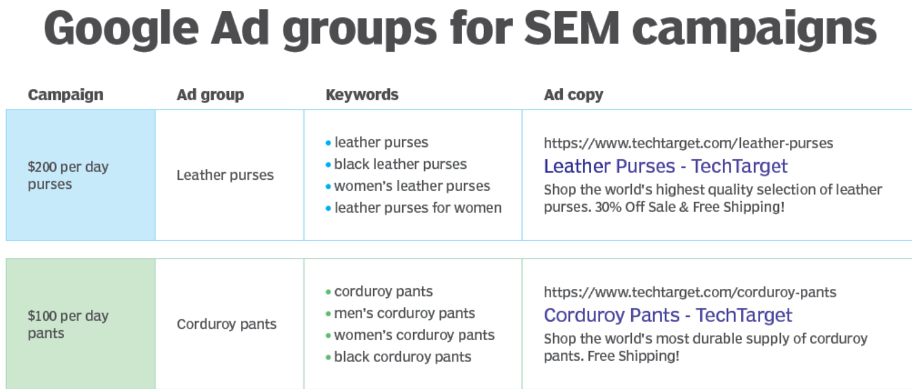
Ad groups
Week # 14-15
GOOGLE ADS
By: Sahar Andaleeb

Slide 30
Ad campaign strategy …cont.
Design and test landing page: Develop a landing page that aligns with your ad and encourages conversions.
Google evaluates landing page UX as part of its ad quality (QS) assessment, so your landing page should be fully optimized and relevant.
Test variations for effectiveness.
Create the Ad: Craft compelling ad copy that includes relevant keywords.
Make a Bid: Set bids for keywords, indicating how much you're willing to pay for clicks.
Monitor the Campaign: Regularly track performance metrics, adjust bids, and refine ad copy based on data insights.
Week # 14-15
GOOGLE ADS
By: Sahar Andaleeb

Slide 31
Search Ad creation
Basic Features of a Search Ad:
Headline: The headline is displayed at the top (the part of the ad that is hyperlinked and appears in blue on Google).
Headlines have a 30- or 35-character limit.
Description: Beneath the headline, you’ll find a text that’s a brief description.
The descriptions have a 90-character limit.
Ad Extensions (Optional): Extensions are optional but give advertisers different possible actions someone could take on the ad.
It enhances your ads with additional information like site links, callouts, and location extensions. cont…
Week # 14-15
GOOGLE ADS
By: Sahar Andaleeb

Slide 32
Search Ad creation
Ad extensions …cont.
Site Links: These are additional links that appear below the main ad text, directing users to specific pages on your website.
For Sparkle Jewelry, site links could include "Shop Earrings," "View Bracelets," or "Explore Collections."
Callouts: Callouts are short snippets of text that highlight key selling points or benefits of your products or services.
For Sparkle Jewelry, callouts could emphasize features like "Free Shipping," "24/7 Customer Support," or "100% Satisfaction Guarantee."
Location Extensions: If Sparkle Jewelry has physical store locations, location extensions would show the address, phone number, and a map marker alongside the ad. This helps users find the nearest store.
For example, "Visit us at 123 Main Street" could be displayed alongside the ad.
Week # 14-15
GOOGLE ADS
By: Sahar Andaleeb

Slide 33
Search Ad creation
Landing Page URL: Web address where users are directed after clicking on your ad.
URL: The main website address of Sparkle Jewelry, such as www.sparklejewelry.com
Final URL: It's the specific webpage where your ad directs users for an ad promoting a diamond necklace, like www.sparklejewelry.com/necklaces/diamond-necklace
Bid Strategies: Choose how you want to bid for clicks, such as manual CPC, automated bidding, or enhanced CPC.
Targeting Options: Specify the geographic locations, languages, and devices where you want your ads to appear.
Ad Scheduling: Control when your ads are shown by setting specific days and times
Week # 14-15
GOOGLE ADS
By: Sahar Andaleeb

Slide 34
Cpc vs. ppc
PPC stands for Pay-Per-Click, which is a type of online advertising model where advertisers pay a fee each time one of their ads is clicked. It is essentially a way of buying visits to your site, rather than attempting to earn those visits organically. PPC is a broad term that encompasses various ad formats, including search ads, display ads, social media ads, and more.
CPC stands for Cost-Per-Click, which is a metric that indicates the actual cost you pay for each click on your ad in a PPC campaign.
CPC is an important metric to measure the effectiveness and cost-efficiency of your PPC campaigns.
It is calculated by dividing the total cost of your clicks by the total number of clicks.
Week # 14-15
GOOGLE ADS
By: Sahar Andaleeb

Slide 35
cpc
Cost-per-click (CPC):
“It's the amount you pay each time someone clicks on your ad. With CPC bidding, you set the maximum amount you're willing to pay for a click on your ad.”
Your max. CPC is the most you'll typically be charged for a click, but you'll often be charged less .
You'll choose between manual bidding (you choose your bid amounts) and automatic bidding (let Google set bids to try to get the most clicks within your budget).
Week # 14-15
GOOGLE ADS
By: Sahar Andaleeb

Slide 36
ecpc
Extended CPC (ECPC): is a bidding strategy used in Google Ads that automatically adjusts your manual CPC bids to increase the likelihood of conversions.
It raises your bids when there's a higher chance of conversion and lowers them when the chance is lower.
ECPC aims to maximize conversions while staying within your set budget.
Week # 14-15
GOOGLE ADS
By: Sahar Andaleeb

Slide 37
CPM
CPM (Cost Per Mille): is a bidding strategy where advertisers pay for every 1,000 impressions of their ad.
Unlike CPC (Cost Per Click), where advertisers pay for clicks, CPM focuses on impressions, meaning advertisers pay for the number of times their ad is displayed, regardless of whether it's clicked or not.
CPM is commonly used for display and video campaigns where the goal is to increase brand awareness or reach a large audience.
Week # 14-15
GOOGLE ADS
By: Sahar Andaleeb

Slide 38
CPM …cont.
Example:
Let's say you ran an ad campaign that cost $500 and received 200,000 impressions.
CPM = Total Cost/Total Impressions x1000
= (500/200,000) x1000
= $2.50
This means you paid $2.50 for every 1,000 impressions of your ad.
Week # 14-15
GOOGLE ADS
By: Sahar Andaleeb

Slide 39
cpa
Cost Per Acquisition (CPA) in Google Ads is the average cost you pay for each conversion, such as a sale or a lead.
Acquisition -the action you want users to take after interacting with your ad.
Example:
If you spent $500 on a Google Ads campaign and it resulted in 20 sales, your Cost Per Acquisition (CPA) would be $25 per sale.
Cost Per Acquisition (CPA) = Total Ad Spend/ No. of new customers
Week # 14-15
GOOGLE ADS
By: Sahar Andaleeb

Slide 40
Roas
ROAS (Return on Advertising Spend) is a key performance indicator used to measure the effectiveness and profitability of advertising campaigns (ad Spend). It indicates how much revenue is generated for each dollar spent on advertising.
ROAS= Revenue from Ads​/Ad Spend
Example:
Total Ad Spent = $5000
Total revenue generated from Ads =15000
ROAS = 20000/5000 = 4 or 400%
Interpretation of ROAS
➔ For every $1 spent you are generating $4
Week # 14-15
GOOGLE ADS
By: Sahar Andaleeb

Slide 41
Roi
ROI (Return on Investment): measures the overall profitability of an investment relative to its cost. It is a comprehensive metric that takes into account all costs and returns, giving you a complete picture of how profitable an investment is.
ROI= Net Profit/Total cost of Investment x 100
Example:
Total Ad Spent = $5000
Product Cost = $10000 (100 units x $100 actual cost per unit)
Revenue = 20000 (100 units x $200 sale price per unit)
ROI = Net Profit/Total Cost
Week # 14-15
GOOGLE ADS
By: Sahar Andaleeb

Slide 42
Roi …cont.
ROI = Net Profit/Total Cost
Net Profit = Gross profit – Other Expenses (Ad Spend, fees, utility)
Gross Profit = Revenue – Actual Cost
= 20000 – 10000
= $10000
Net Profit = 10000 – 5000
= $5000
ROI = (5000 / 15000) x 100 = 33.33%
Week # 14-15
GOOGLE ADS
By: Sahar Andaleeb

Slide 43
Max bid calculation (only for understanding)
Max. Bid = Value per Conversion × Expected CR × Desired ROAS
Alternatively, if you're working with a cost per acquisition (CPA) target, you can calculate your maximum bid as:
Max. Bid = Target CPA × Expected CR
Value per Conversion: If a conversion generates $100 in revenue, this is your value per conversion.
Expected Conversion Rate: If you estimate that 5% of clicks convert into sales, then your expected conversion rate is 0.05.
Desired ROAS: This is your desired return on ad spend. If you want to earn $3 for every $1 spent, then your desired ROAS is 3.
Maximum Bid = 100 × 0.05 × 3 = 15
Week # 14-15
GOOGLE ADS
By: Sahar Andaleeb

Slide 44
Google ad formulas
Click-through Rate (CTR) = (Clicks ÷ Impressions) x 100%
Cost Per Click (CPC) = Total Cost ÷ Clicks
Conversion Rate (CR) = (Conversions ÷ Clicks) x 100%
Cost Per Conversion = Total Cost ÷ Conversions
Cost Per Acquisition (CPA) = Total Ad Spend/ No. of new customers
Ad Rank = Bid Price × Quality Score + Extensions etc.
Week # 14-15
GOOGLE ADS
By: Sahar Andaleeb

Slide 45
Cost per acquisition (Cpa)
“CPA: is the cost associated with acquiring a new customer. It includes all marketing and sales expenses divided by the number of new customers acquired.”
Example: You spend $25,000 per month on Google Ads. Each month, you acquire 200 new customers.(subscription model - $50/month)
CPA = Total Spend / Number of New Customers
CPA = 25,000 / 200 = $12
Week # 14-15
GOOGLE ADS
By: Sahar Andaleeb

Slide 46
Customer lifetime value (CLV)
“CLV: is the total revenue a business expects to earn from a customer over the entire duration of their relationship.”
It helps businesses understand how much they can spend on acquiring and retaining customers while remaining profitable.
Increasing CLV can help reduce customer acquisition costs (CPA).
Example: Each customer spends \$50 per month on a subscription. The average customer stays subscribed for 12 months.
CLV = Average Monthly Spend x Number of Months
CLV = $50 x 12 = $600
Week # 14-15
GOOGLE ADS
By: Sahar Andaleeb

Slide 47
CLV & CPA …cont.
In this example; your
CPA is $125
CLV is $600.
This means that for every $125 spent on acquiring a customer, you can expect to earn $600 over the customer's lifetime.
This ratio indicates a healthy return on investment, as the revenue generated from each customer significantly exceeds the acquisition cost.
Understanding these metrics helps you optimize your marketing strategies and budget allocation to maximize profitability.
Week # 14-15
GOOGLE ADS
By: Sahar Andaleeb

Slide 48
Relationship between (CLV) & (CPA).
Increasing CLV can help reduce customer acquisition costs (CPA).
Let’s assume you increase CLV from $600 to $750 by getting customers to stay longer or spend more.
Now, even though your CPA remains the same), the higher CLV means that the revenue generated from each customer is greater than before.
Effect on Profitability and Scaling:
If CLV increases to $750 but CPA stays at $125, you’re now getting more return from each customer, meaning you're more efficient in your ad spend.
Profit per customer = CLV - CPA
= 750 - 125
= $625
(previously, it was $475 with a CLV of $600).
Week # 14-15
GOOGLE ADS
By: Sahar Andaleeb

Slide 49
CLV & CPA … key take aways
Increasing CLV increases revenue overtime.
CPA helps to measure whether the ad spend is cost-effective in acquiring new customers.
The business can use CPA to assess how much it’s paying to bring in each new customer and determine if this cost aligns with the revenue each customer generates.
Week # 14-15
GOOGLE ADS
By: Sahar Andaleeb

Slide 50
Relationship Between CPA, ROAS, & ROI:
ROAS (Rs. 16.6x) tells us how much revenue is generated for each rupee spent on advertising. This is important, but CPA takes it a step further by giving insight into how much each individual customer is costing the business.
If the CPA is too high, it could mean that the company is spending a lot of money on acquiring each customer, which could reduce the overall profitability (and ROI) of the business.
A lower CPA indicates that the business is acquiring customers more efficiently, which would contribute to better profitability and a higher ROI.
Week # 14-15
GOOGLE ADS
By: Sahar Andaleeb

Slide 51
market segmentation
Demographic Segmentation
Geographic Segmentation
Psychographic Segmentation
Behavioral Segmentation
Week # 14-15
GOOGLE ADS
By: Sahar Andaleeb

Slide 52
Demographic Segmentation
Demographic Segmentation:
Dividing the market based on factors such as age, gender, income, education, occupation, and family status.
Example:
“Luxe Apparel” targets both men and women but offers separate campaigns for each group. For women, they may promote formal wear and trendy dresses for ages 25-40 with disposable incomes of around Rs. 50,000/month and above. For men, they may promote business casual or premium men's wear, targeted at professionals aged 30-45 with a higher income.
Week # 14-15
GOOGLE ADS
By: Sahar Andaleeb

Slide 53
Geographic Segmentation
Geographic Segmentation:
“Segmenting based on location, such as country, region, or even city.”
Example:
“Luxe Apparel”could target fashion-conscious individuals in major cities like Karachi, Lahore, and Islamabad with trendy clothing styles. However, in smaller cities like Faisalabad or Multan, they might promote more traditional or culturally specific clothing, like shalwar kameez or ethnic wear.
Climate: They can also adjust campaigns based on weather. In cities with warmer climates, like Karachi, they might promote summer dresses, shorts, or light fabrics. Meanwhile, in cities with colder climates like Murree, they could focus on offering sweaters, jackets, and winter coats.
Week # 14-15
GOOGLE ADS
By: Sahar Andaleeb

Slide 54
Psychographic Segmentation
Psychographic Segmentation:
“Segmenting based on lifestyle, values, interests, and personality traits.”
Example:
A brand like Nestlé Pakistan, which sells dairy and health-focused products, could target health-conscious individuals. They might promote products like Nestlé Yogurt or Nestlé Milk in a campaign aimed at families who prioritize healthy eating and wellness.
If they know that a segment of their audience is interested in fitness, they could promote protein-rich products or snacks for people who regularly go to the gym, creating a campaign for people who value healthy living.
Week # 14-15
GOOGLE ADS
By: Sahar Andaleeb

Slide 55
Behavioral Segmentation:
Behavioral Segmentation:
“Dividing the market based on consumer behaviors such as purchase history, brand loyalty, or product usage.”
Example: An online e-commerce platform like Daraz.pk can segment its audience based on purchase history or browsing behavior. For example, if a customer has previously bought a mobile phone, Daraz might send targeted emails or notifications about mobile accessories like cases, chargers, or headphones.
Similarly, Daraz might target frequent shoppers by offering them exclusive discounts or loyalty rewards, increasing repeat business.
Week # 14-15
GOOGLE ADS
By: Sahar Andaleeb

